Slide 1
Team SciFly
Mary, Komal, Philip, Tony, & Nathan

Slide 2





THE USER
A typical DNA extraction experiment requires ~$127 of materials (test tubes, funnels, graduated cylinders, etc.). That’s over a quarter of the yearly science budget for some teachers for a single experiment. Where and how can I find more supplies?
91% of teachers tell us that the biggest challenge to implementing laboratory activities in the classroom is lack of supplies (107 out of 117 Georgia life science teachers surveyed)¹
USER PROBLEM: Where and how can I get more supplies as a science teacher to teach my class?
$1.50 / student
*$450/year
$3.00 / student
*$600/year
Assuming 300 students, ¹ http://www.georgiabioed.org/education/equipment-depot/
Notes:
Imagine that you are a science teacher teaching in a junior high or high school located in rural areas of Georgia. Also, imagine that every year you get at minimum of $1.50 per student to spend on science supplies.
Now imagine that you want to do a DNA extraction experiment. Purchasing the supplies alone can cost you over a quarter of your yearly science budget for one simple experiment. Now imagine that you had planned on 5 science experiments in the year. You’ve blown your budget.
91% of teachers say that their biggest challenge in implementing lab experiments is the lack of supplies. How do you, as a science teacher get access to supplies that you need to teach your class?
Test tube rack = $5.50/rack
Eye Droppers = $10/pk of 110
Funnel = $10/pk of 65
Test Tubes = $27/case of 1000
Graduated cylinder = $10/each
Total cost for 10 stations: ~$127

Slide 3
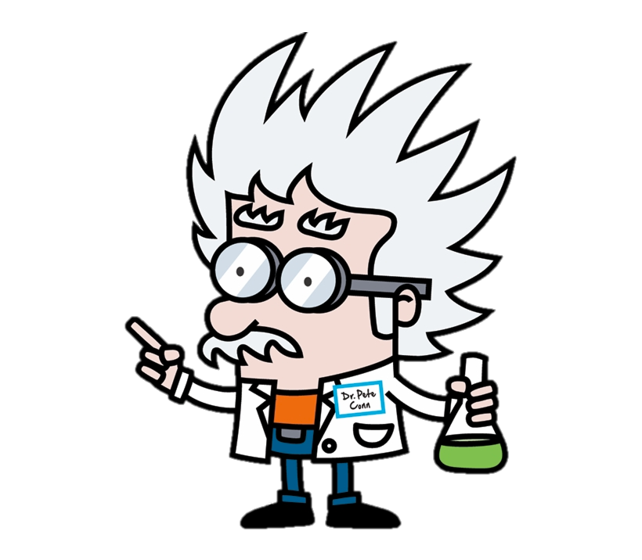


THE SMALL NON-PROFIT
Georgia BioEd Institute’s Equipment Depot provides grades 6-12 teachers with the laboratory supplies and equipment they need to prepare students for careers in the life sciences.
Supply donations are collected from companies and universities and provided to schools that desperately need it
NON-PROFIT PROBLEM: How can GABioEd manage its inventory of donations when the information is kept in different locations, managed by various volunteers, and not easily accessible by the educators who need them?
Notes:
Now imagine that there is a small non-profit, Georgia BioEd, who has the very solution to the teachers’ problems. Georgia BioEd has an Equipment Depot that houses donations of laboratory supplies from companies and universities and provides grades 6-12 teachers with the supplies and equipment they need to prepare students for careers in the life sciences.
However, because they are a small non-profit working on a shoestring budget, they rely on volunteers (such as myself) and google drive apps to help run their program. They maintain their inventory of laboratory supplies on spreadsheets and send out google drive links to teachers to see what you have to select from in their inventory.
Their biggest problem is how can they manage inventory of donations when the information is kept in different locations, managed by various volunteers, and not easily accessible by the educators who need them?

Slide 4

WHO WE ARE AND WHY WE DID THIS?
Parts-to-Purpose
Who we are - We are a group of IT developers looking to build simple solutions to help small nonprofit organizations
Our Product - Parts-to-Purpose is an open-source, inexpensive inventory and people management platform that nonprofits can use to manage their inventory of donations, donors, and donees
Our Goal - To help nonprofits meet their mission by immediately connecting the “purpose” in need to the “part” that’s needed
Notes:
That’s where we come in. We are a group of IT developers looking to build simple solutions to help small nonprofit organizations. Our app is called Parts-to-Purpose. It is an open-source, inexpensive inventory and people management platform that nonprofits can use to manage their inventory of donations, donors, and donees. Our overall goal is to help nonprofits meet their mission by immediately connecting the “purpose” in need to the “part” that’s needed.

Slide 5

PARTS-TO-PURPOSE
Key Functions:
Update, manage, and track their inventory of donations
Collect donor and donee information
Provide donees a portal to login, view and select items needed, add to a cart, and arrange for pickup/shipment of their cart
See changes in inventory/stock in near real-time
Collect and visualize metrics to identify needs and trends so that they can use those metrics to focus donation efforts or community marketing
Notes:
That’s where we come in. We are a group of IT developers looking to build simple solutions to help small nonprofit organizations. Our app is called Parts-to-Purpose. It is an open-source, inexpensive inventory and people management platform that nonprofits can use to manage their inventory of donations, donors, and donees. Our overall goal is to help nonprofits meet their mission by immediately connecting the “purpose” in need to the “part” that’s needed.

Slide 6
OUR PROCESS
1
2
3
4
5
6
7
Project Plan Generation
Wireframe Mock-up
User Story Development
Database Modeling
Technology Selection
Coding
Deployment
Fully functional and responsive MVP
Created schedule
Used GitHub PM tools (Kanban board)
Established milestone deadlines
Created/Assigned Tasks
GoMockingBird
Created 13 User Stories
5 User Stories became MVP
Utilized real dataset from non-profit partner
Created proof-of-concept to determine SQL or Mongodb direction
MDBReact
bcrypt
nodemailer
rcTouchable
Code Reviews
Unit Testing
End-to-End Testing
Continuous Deployment
Deployment to Heroku
Notes:
We followed a 7-step process from planning to design to implementation.

Slide 7
DEMO
https://parts-to-purpose.herokuapp.com/
Notes:
We followed a 7-step process from planning to design to implementation.

Slide 8
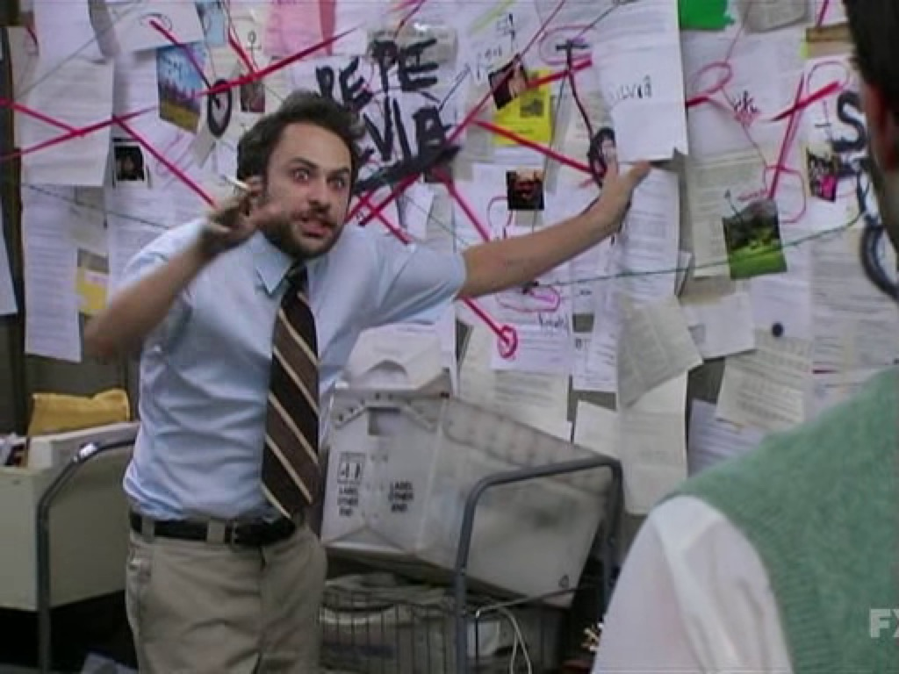
DIFFICULTIES
React Bootstrap/MDB Conflicts:
Early on we wanted to use a stylish database
An error with Modals was preventing us from using MDB
Down the line we figured out Modal issue and implemented MDB
The caused the site to take on a nigh-”Frankenstein” of website aesthetic.
Eventually Phil went in and changed every React Bootstrap component to an MDS Component.
The Cart
Everything with the Cart
Went through more iritive changes than any other single component.
Every small change brought lots of bugs
Keeping track of items in/out of cart.
Clearing Cart on Order Submission
Disabling Submit for an Empty Cart
Disabling Search Page Add Buttons on Cart Entry
More things we don’t have time for

Slide 9
AWESOME STUFF WE DID
No Major GitHub Conflicts!
Mobile/Tablet/Computer Responsive!
User Email Registration
Dynamic Input Population
Notes:
No Major GitHub - Workong on seperate components in react really helpped with that
Mobile Responsive - MDB scaling and onClick vs onTouch
User Email Regisration - We showed during demo, but we think this is a pretty cool feature
Dynamic Input Population- Also showed during Demo, but getting the React to be as responsive as possible is cool to see

Slide 10

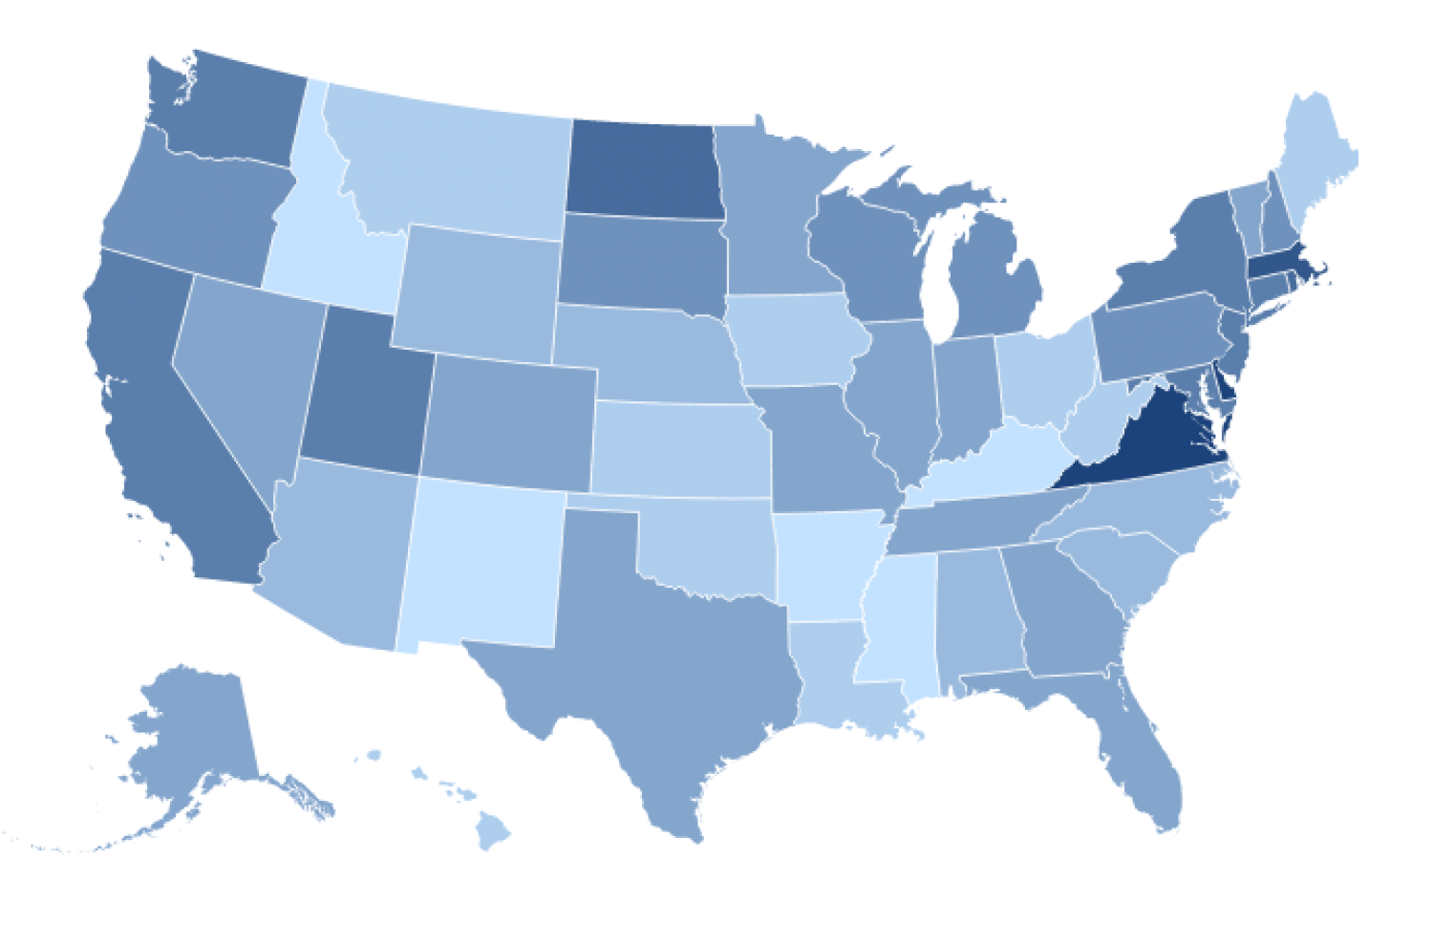

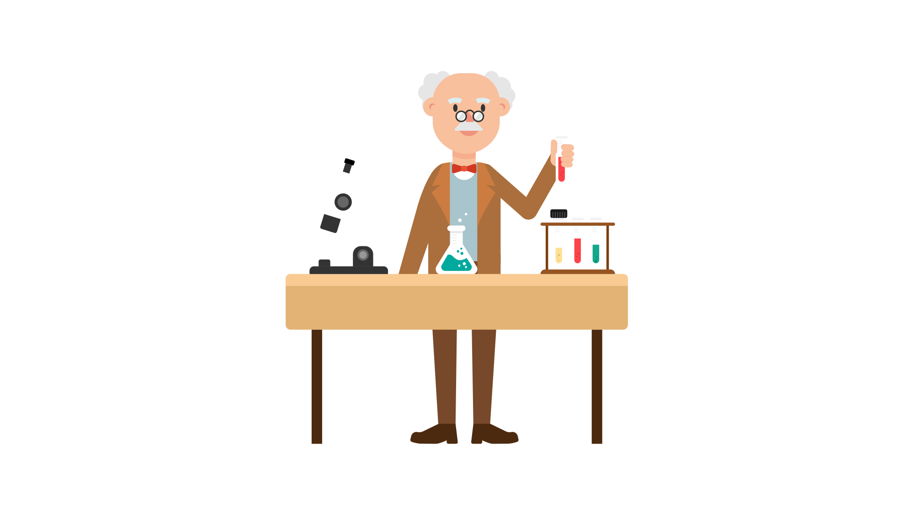

Future Features
Admin Page
Update, manage, and track their inventory of donations
Give them their own support options for users
Search Order History
Give users a way to review order history
Also include Print button on the Order Confirmation page
Analytic Data Tracking
Let Admins track inventory requests and patterns
Gives Admins more reactive power to the needs of their donatees
Notes:
Admin Page- Currently there is no admin accounts and if a charity wants to be a parter, they would have to send to us
Search Order History - Useful for collecting data and tracking expindetures. The Print button would be an easy way to store order confirm slips locally for users.
Analytic Data Tracking- Tracking user requests, especially for educators, would give admins a way to warn users if a particular item they have requested is not in stock. Gives charity partners a way to look at most in demand items to request from donators.

Slide 11
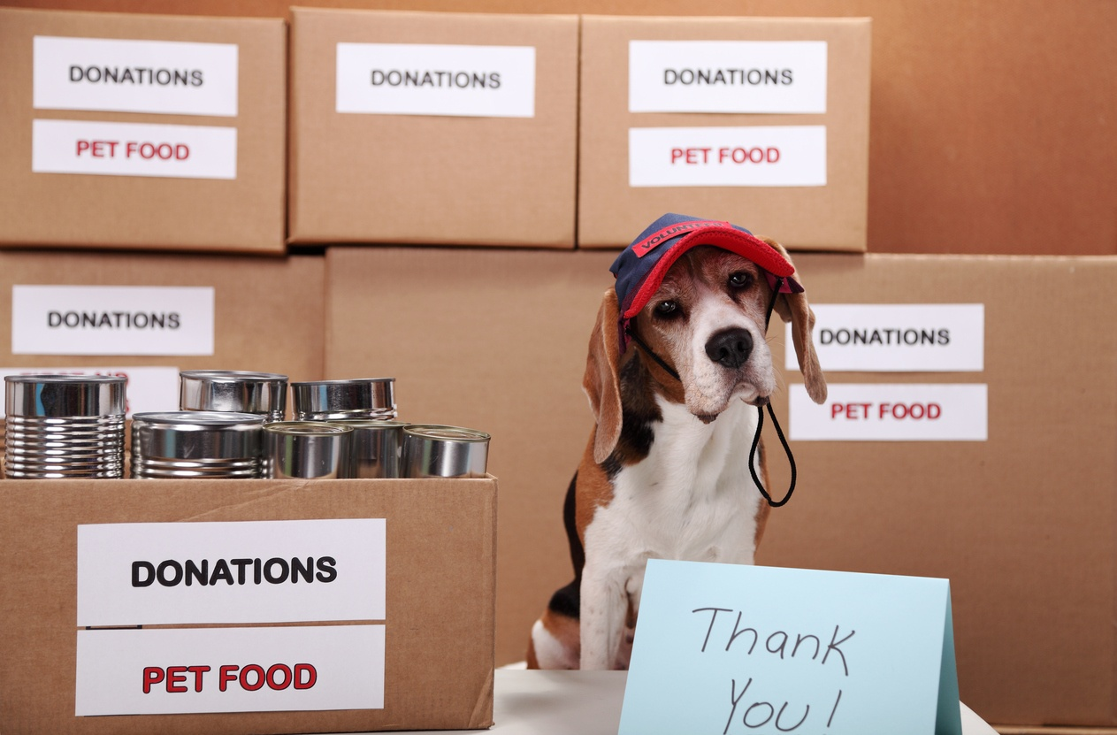





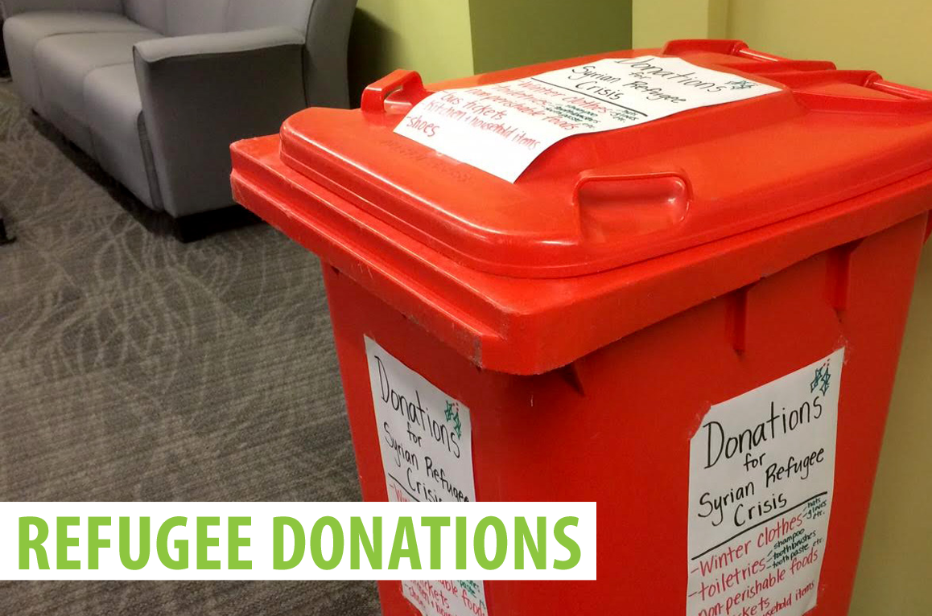
OUR VISION - HELPING OTHERS CONNECT “PARTS TO PURPOSES”
Notes:
Our vision is that in the end, others would be able to re-purpose our application for charities that they’ve created so that we can continue to help others connect ”parts” to their “purpose”

